Slide 1

Final Project
Baseline Checkpoint
G06
組員：
金家逸
王維勤
林桓鈺
2024/05/30

Slide 2
Current Result
Supporting all instructions.
With caches.
Pass test assembly programs (noHazard, hasHazard).
Complete the circuit synthesis with non-negative slack.

Slide 3
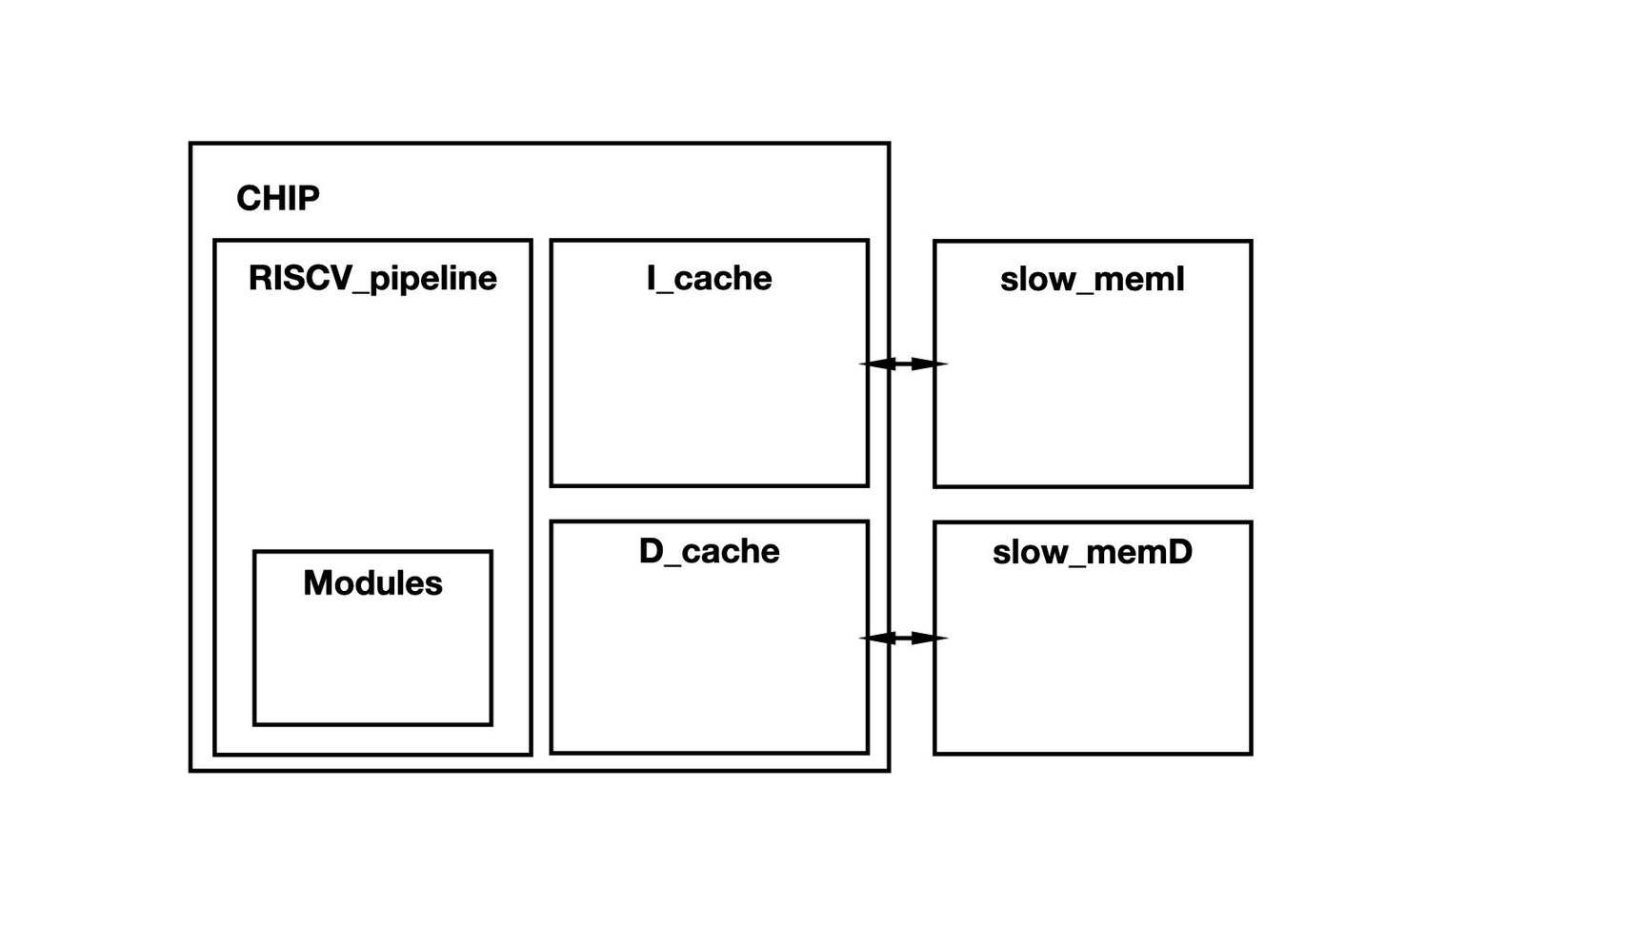
Block Diagram

Slide 4
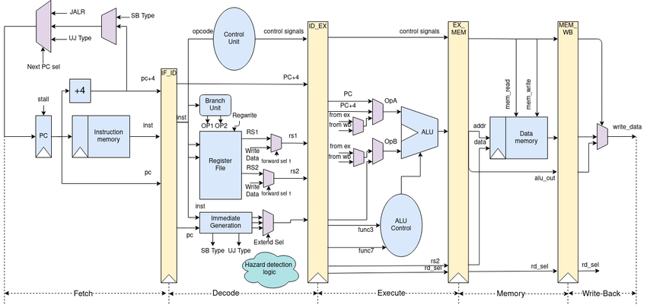
Block Diagram
https://www.researchgate.net/figure/The-RISC-V-ISA-compliant-RV32IM-5-Stage-fully-pipelined-datapath-designed-from-scratch_fig3_355051535

Slide 5
CHIP.v
RISCV_Pipeline.v
cache_dm.v

Slide 6
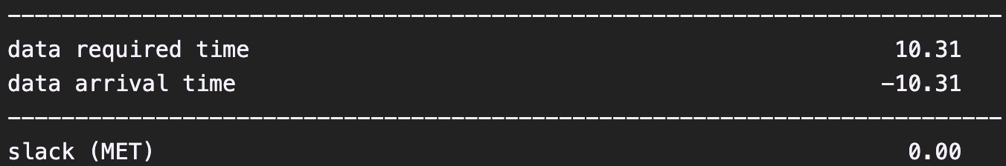
CHIP.v

Slide 7
Future Plans
5/31 ~ 6/7: Preparing for final exams.
Expected to complete the following tasks by 6/14:
Branch prediction mechanism.
Supporting compressed instructions.
Supporting multiplication instructions.
6/15~6/16: Synthesis and checking for any other issues.

Slide 8
Work Assignment Chart
金家逸:
RISCV Pipeline.
Prediction mechanism(due: 6/14).
王維勤:
Synthesis.
Compressed instructions(due: 6/14).
林桓鈺:
Multiplication instructions(due: 6/14).
PPT.

